Slide 1
48v Cryo Board to Cryo Cooler

Slide 2
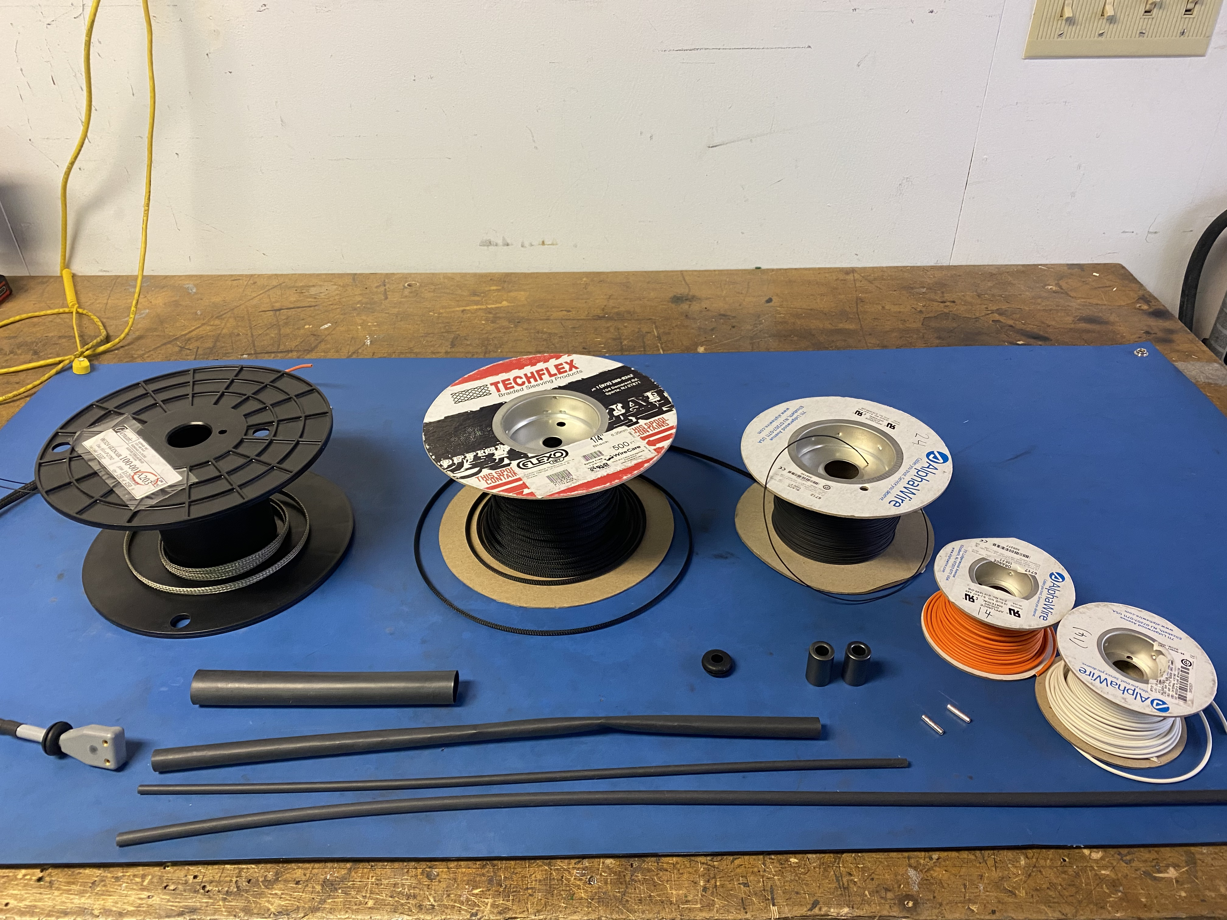
Materials

Slide 3
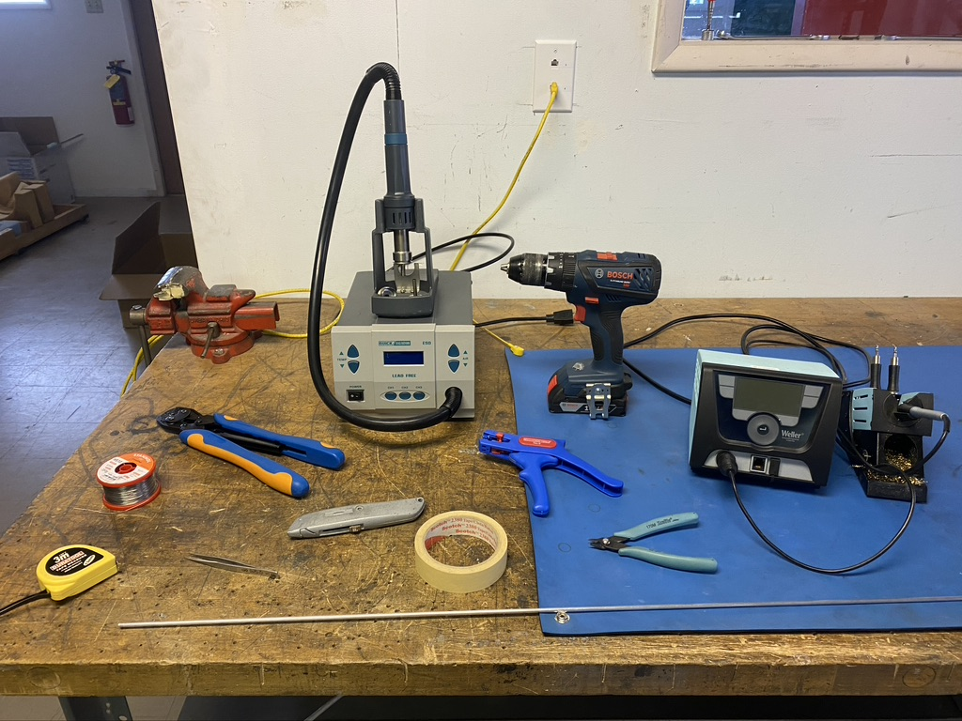
Tools

Slide 4
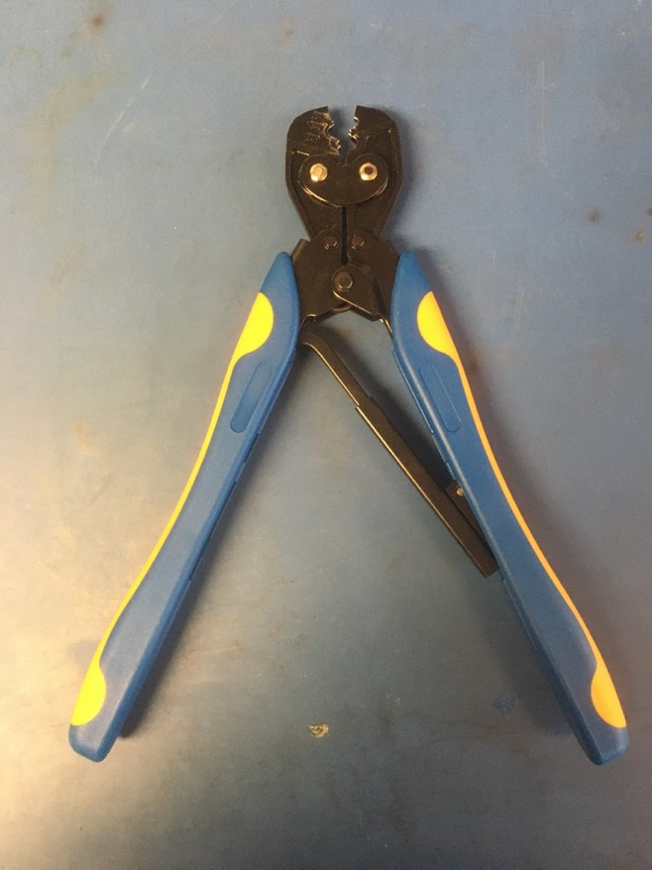
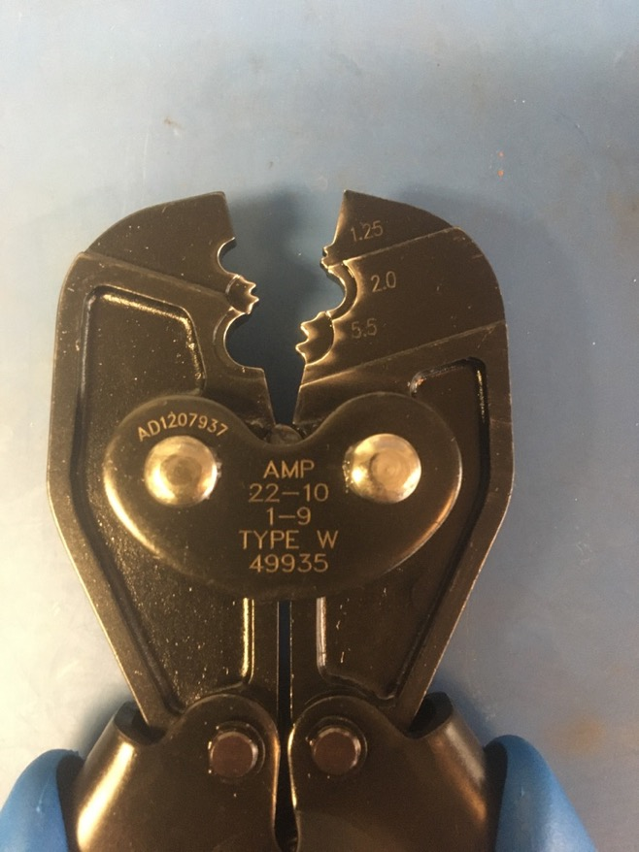
Crimping Tool

Slide 5
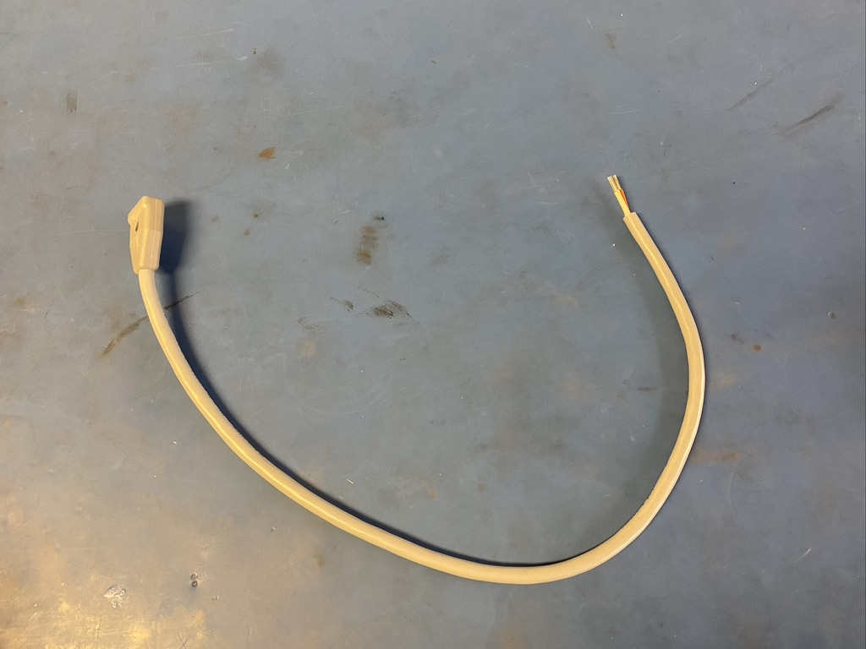
The power cord that comes with each cryocooler appears as shown. For our purposes, it needs to be retrofitted.

Slide 6
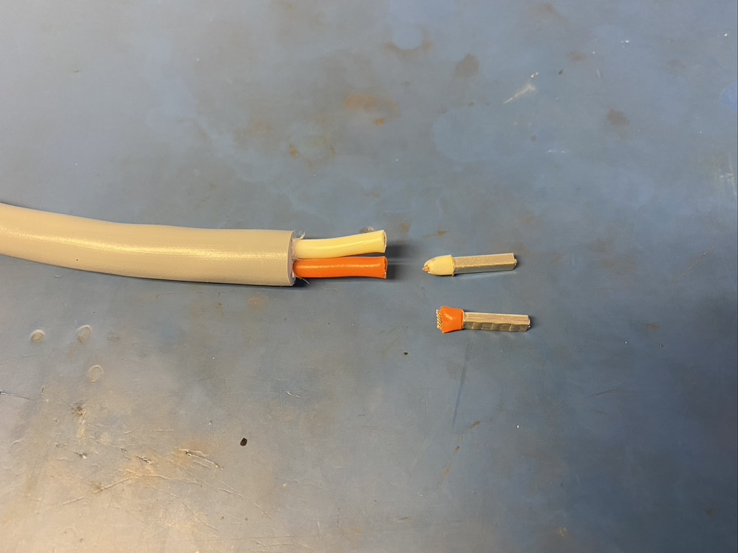
Cut the ferrules off the harness.

Slide 7
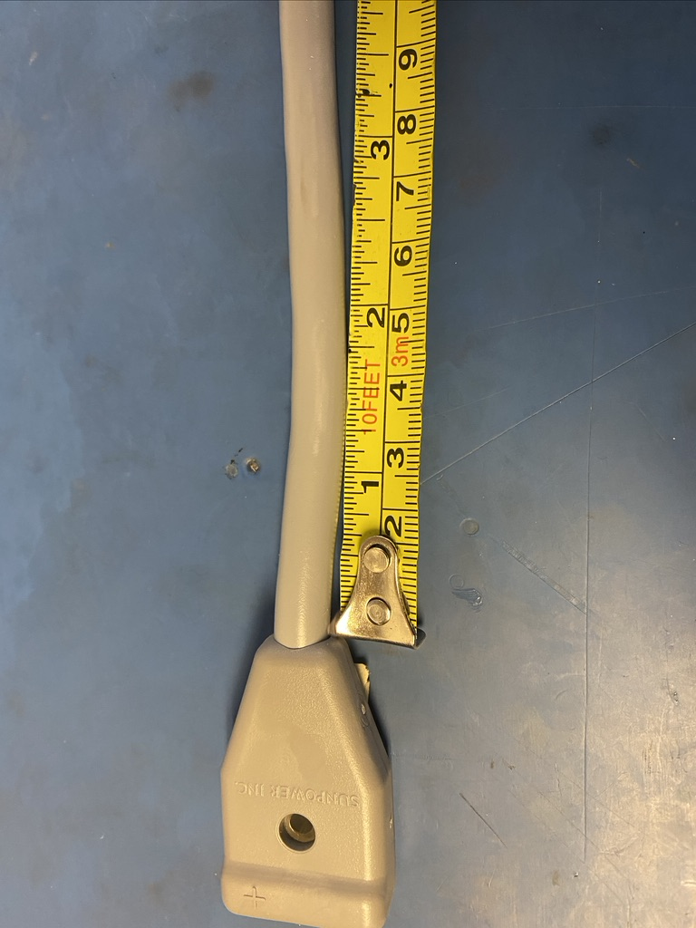
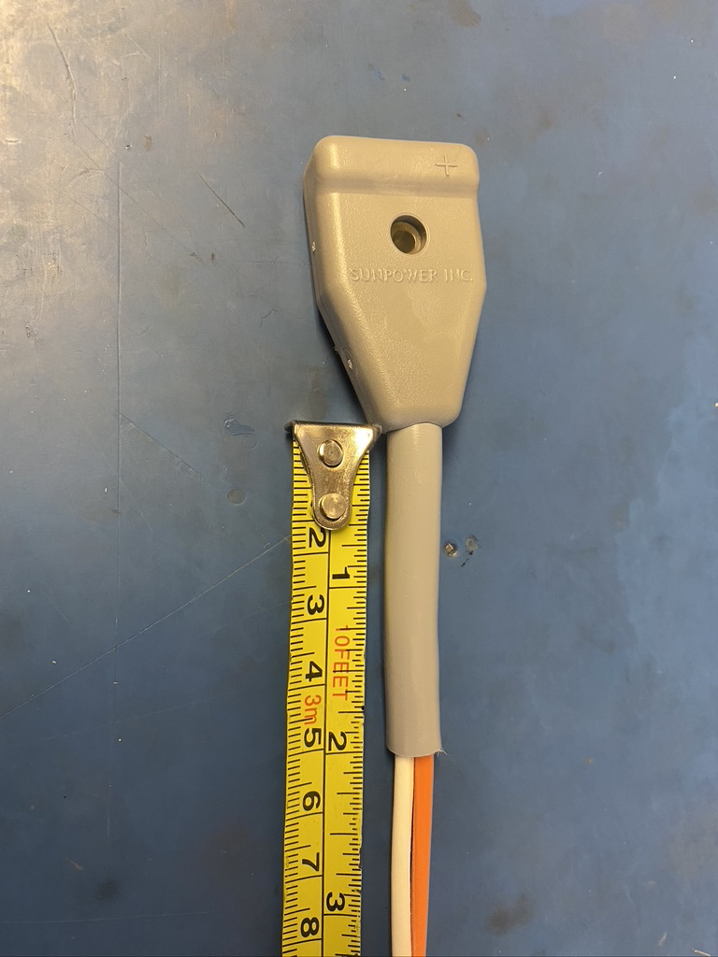
Using the box cutter, carefully cut the grey isolation at 2 inches from the power plug. Then pull the isolation completely off the harness.

Slide 8
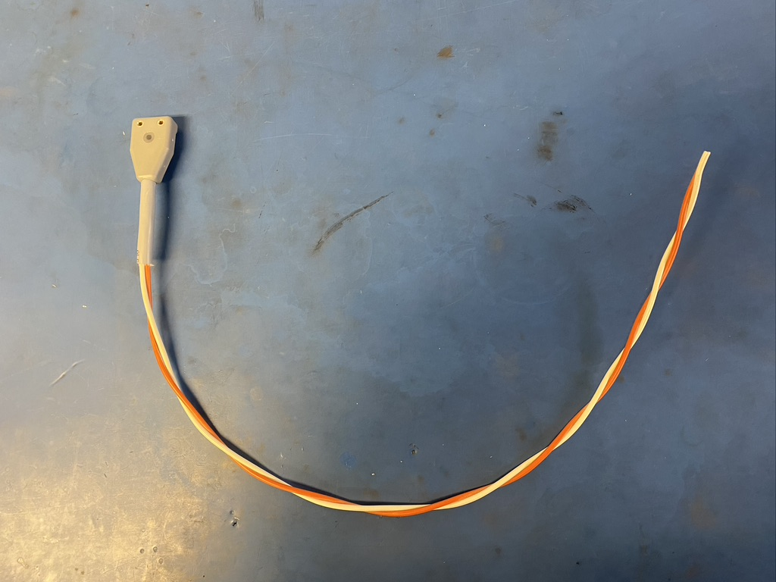
Once the isolation is removed, the orange and white wires will be twisted. Leave those twists so that the harness appears as shown.

Slide 9
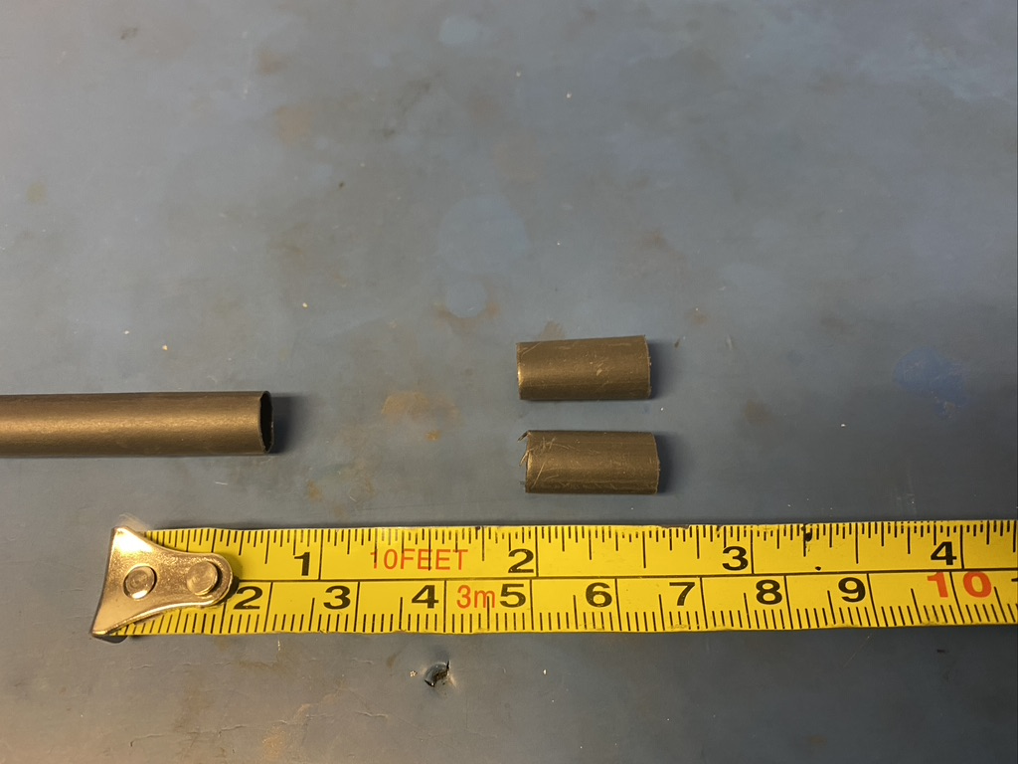
Measure out and cut two lengths of 6.4mm adhesive shrink tube each .5in long.

Slide 10
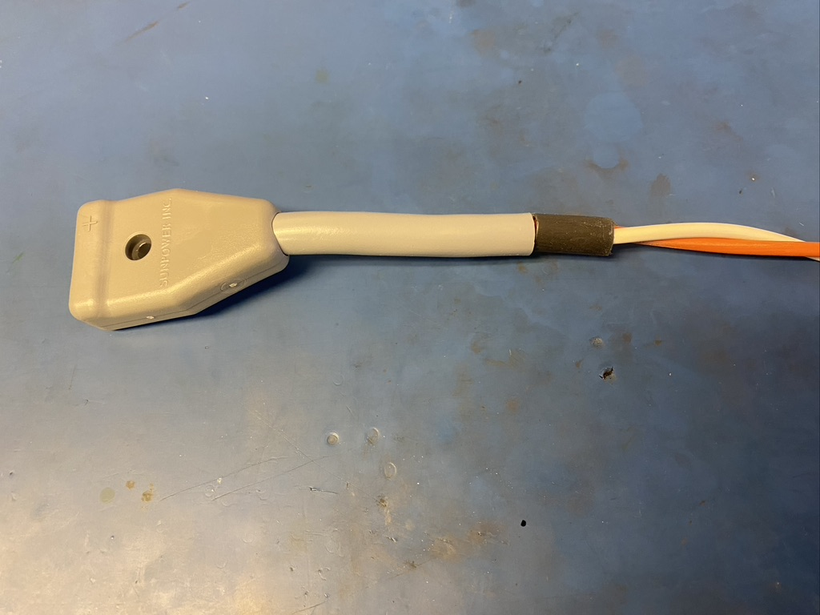
Place one of the pieces of shrink tube on the wire harness next two the power plug.

Slide 11
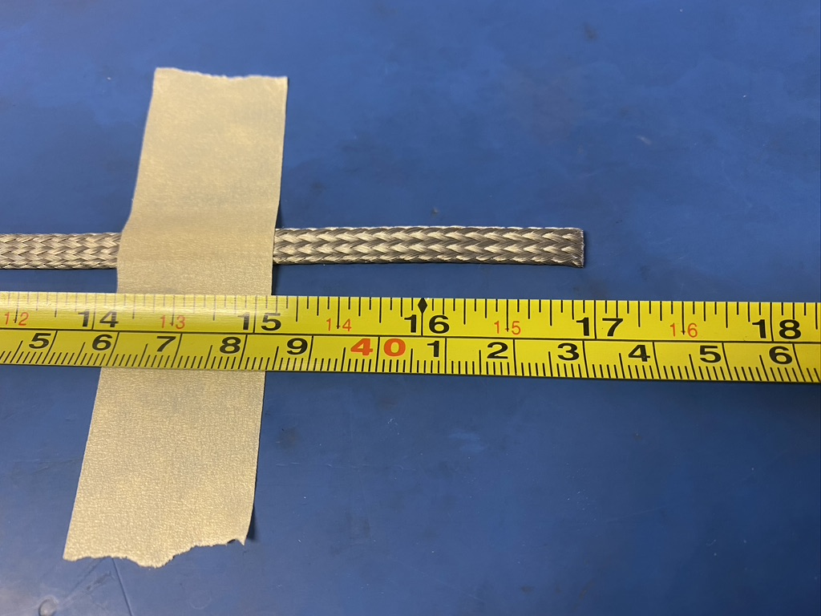
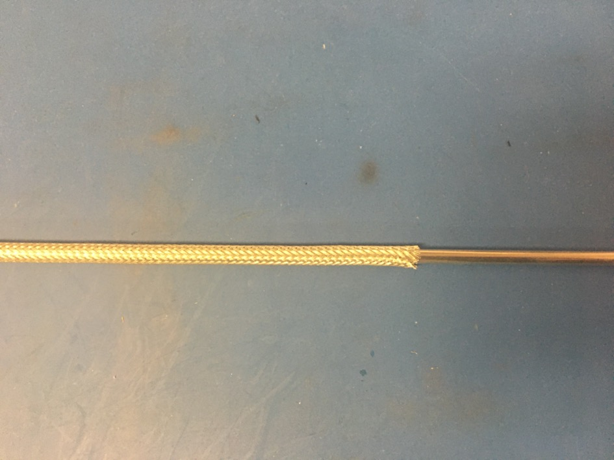
Measure out 17in inches of the .203 metal braid. Expand it using the metal rod.

Slide 12
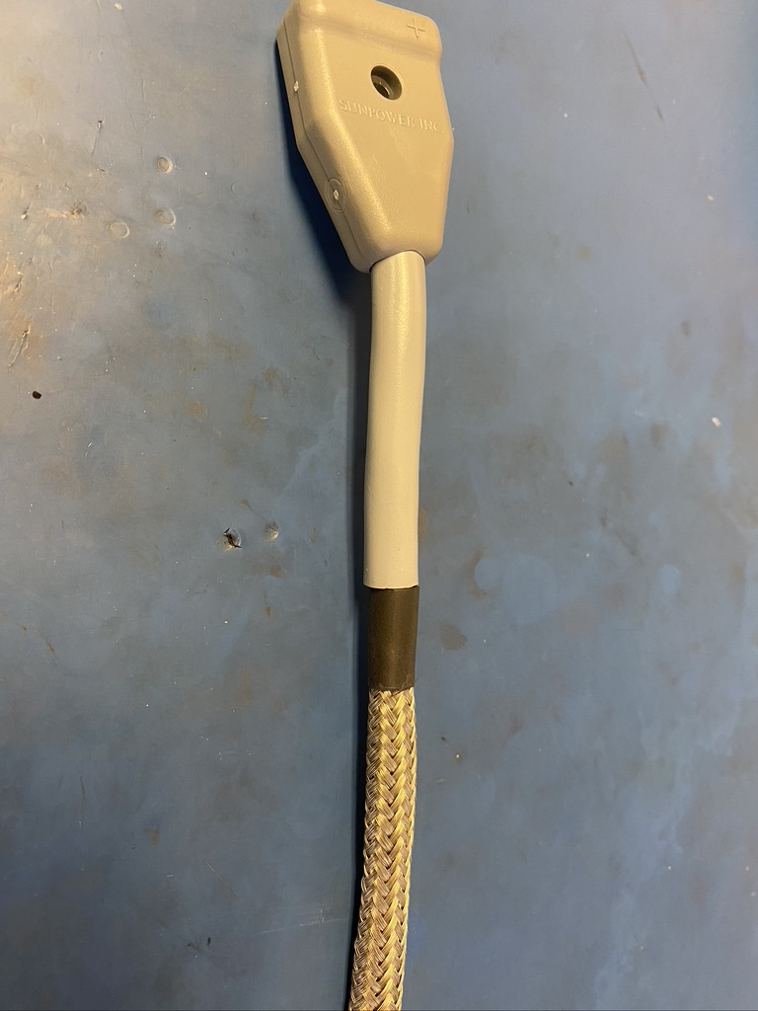
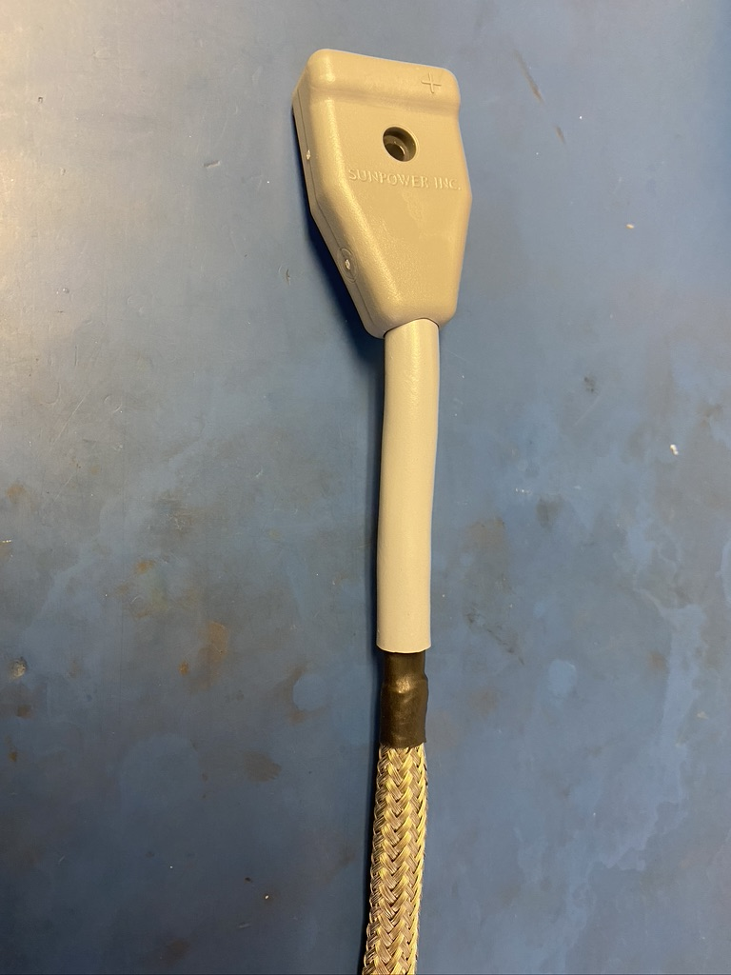
Put the metal braid onto the wire harness. Place the end of the braid next to the plug and under the piece of shrink tube. Be sure that the braid ends midway through the piece of shrink tube. Apply the heat gun.

Slide 13
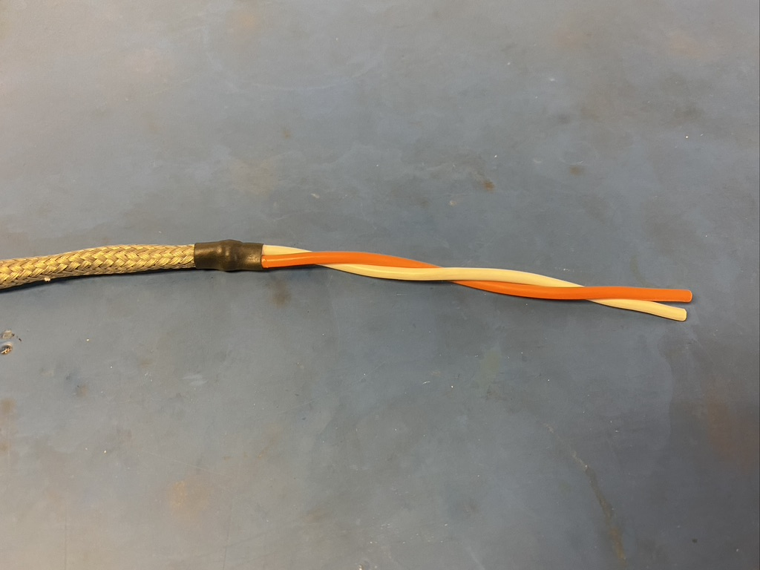
Place the other piece of shrink tube on the other end of the metal braid. Again, the braid should end midway through the length of shrink tube. Apply the heat gun.

Slide 14
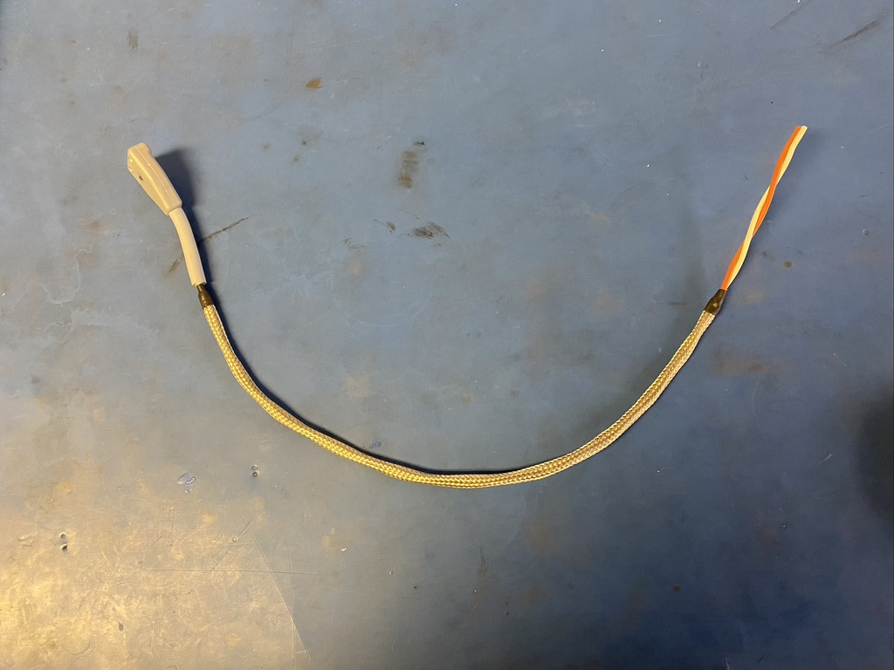
Thus far, the harness should appear as shown.

Slide 15
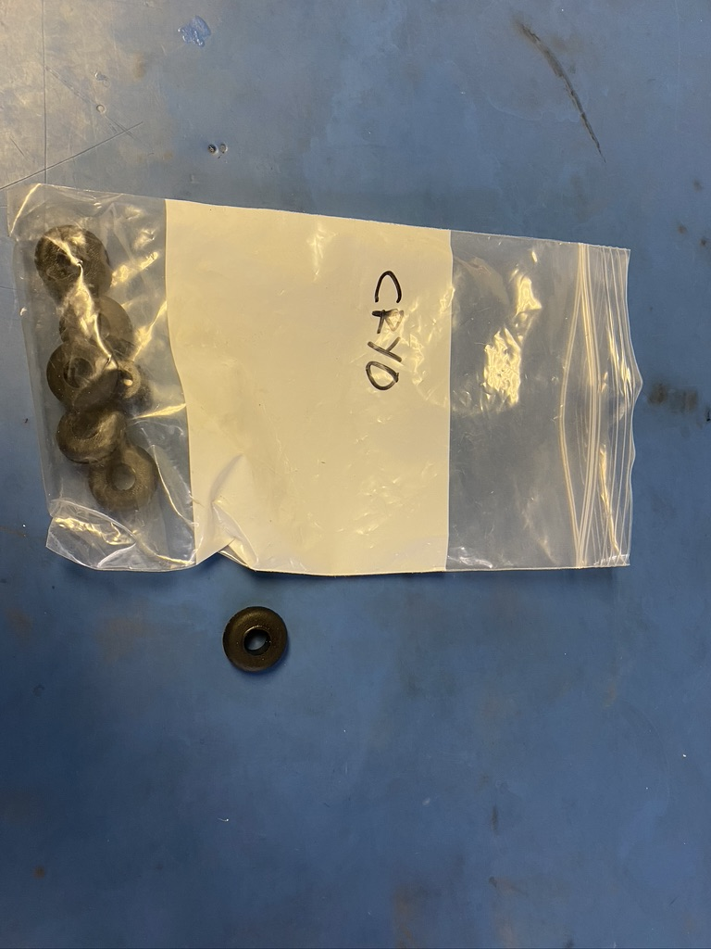
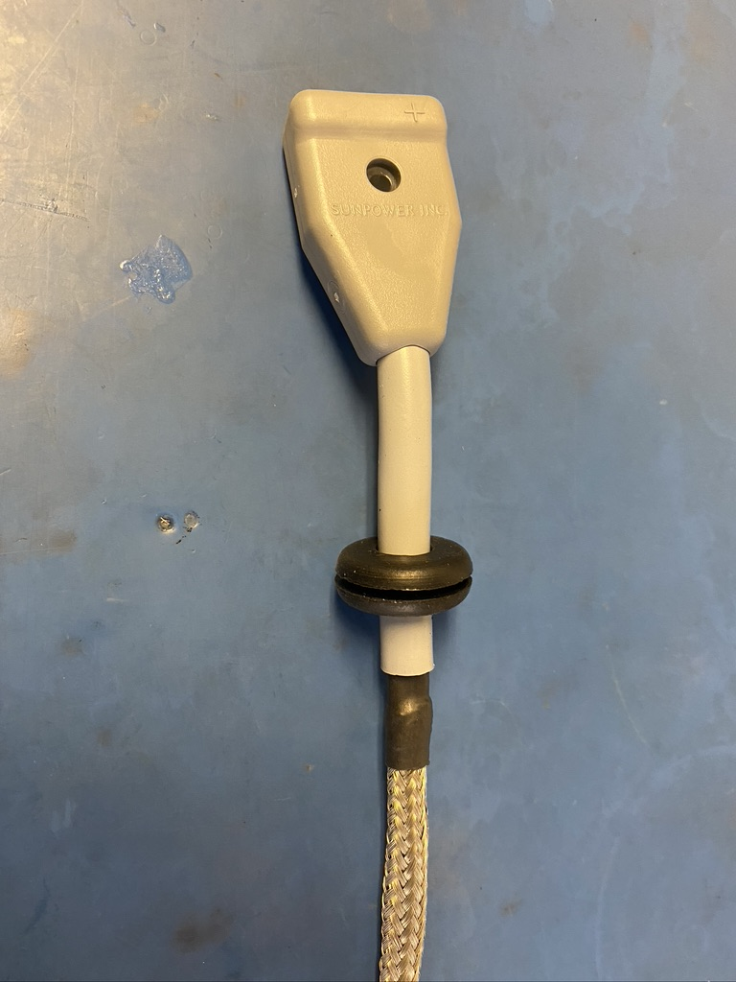
Put a rubber feed through protector on the wire harness. Place it on the two inches of grey isolation next to the power plug.

Slide 16
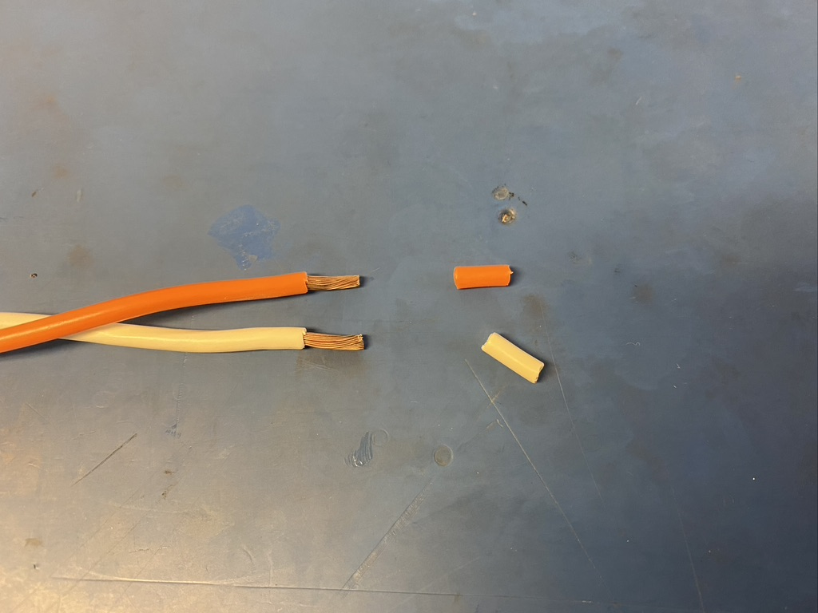
Remove 7mm of isolation off the wire ends of the harness.

Slide 17
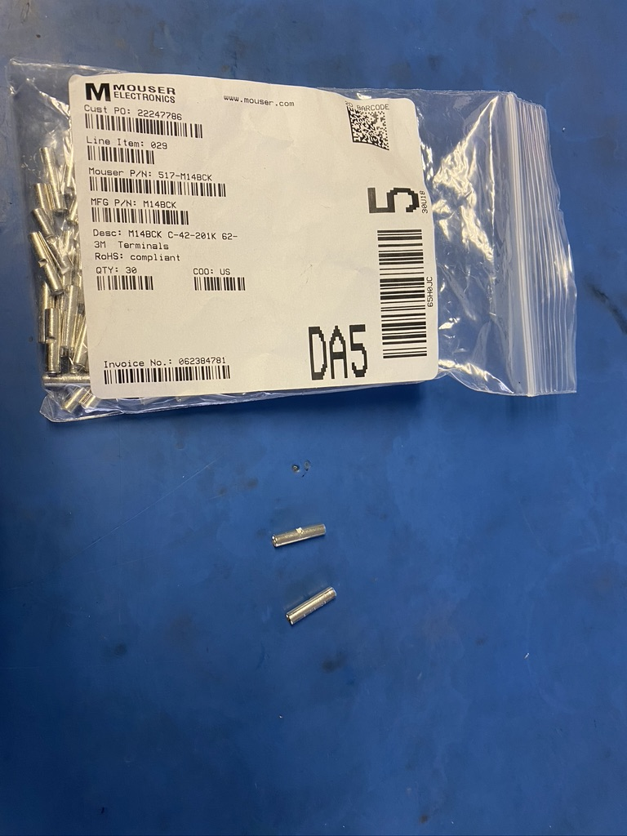
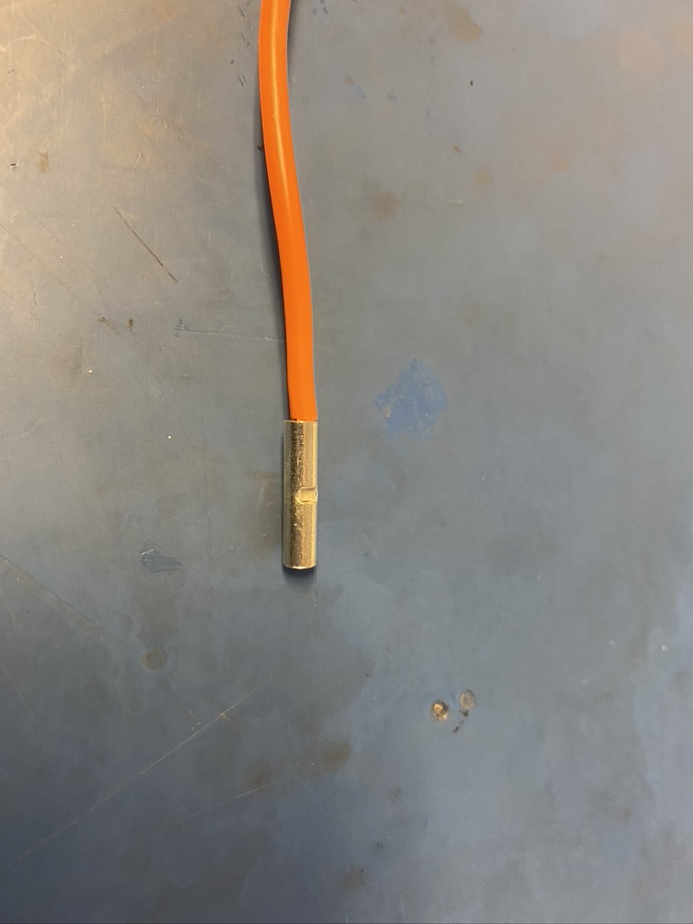
Take two of the 3M terminals and place them on the exposed wire on the harness.

Slide 18
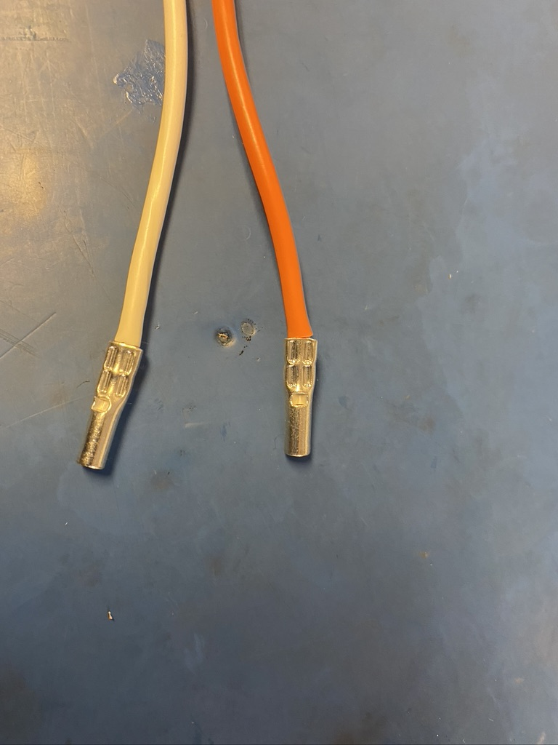
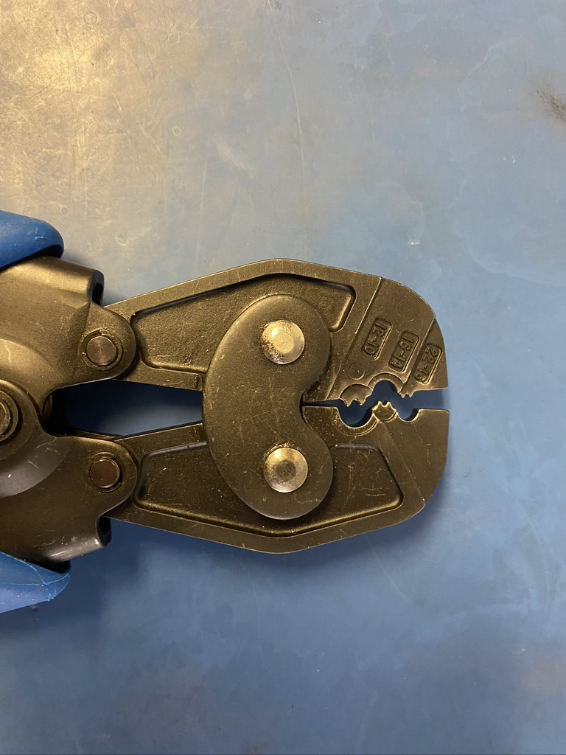
Crimp the terminals twice (two consecutive crimps next to one another as shown on the left) using the crimper’s 12-10 slot.

Slide 19
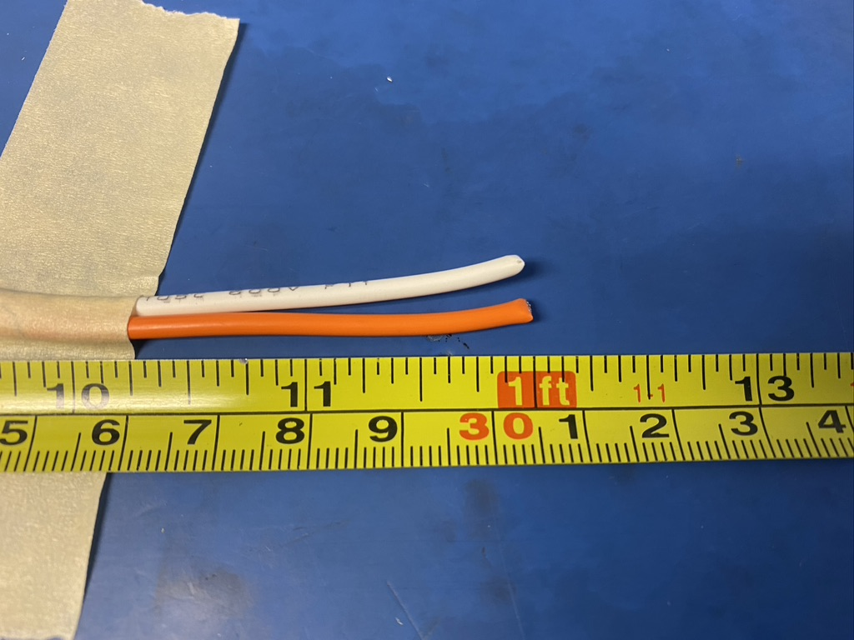
Measure out and cut 12 inches of orange and white 14 awg wire.

Slide 20
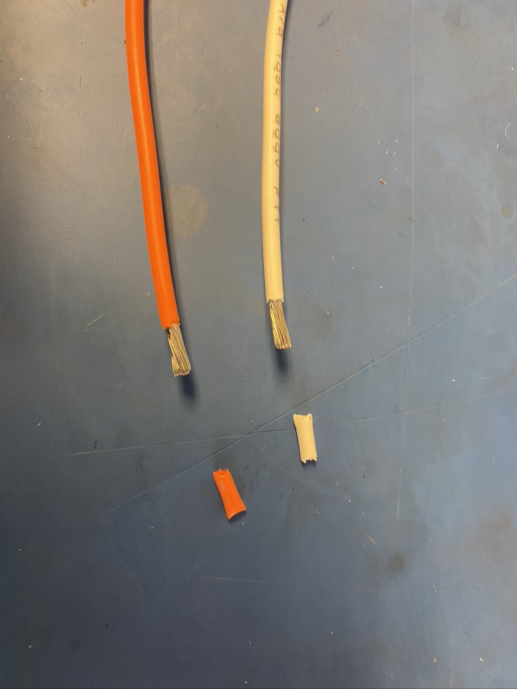
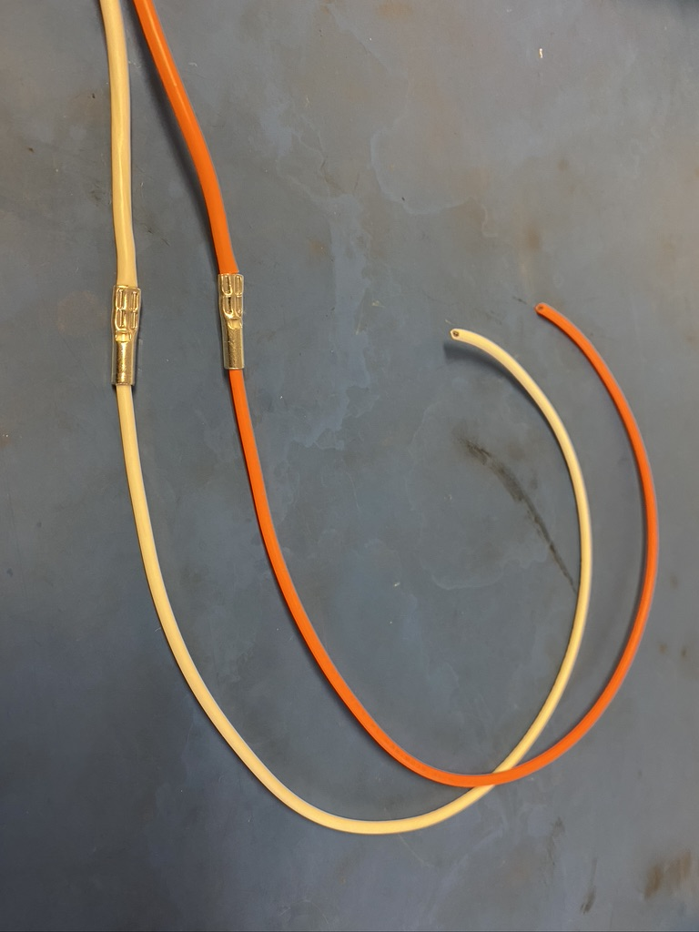
Remove 6 mm of isolation off of one end of each of the wires that were just cut. Place those exposed ends into the other side of the 3M terminals.

Slide 21
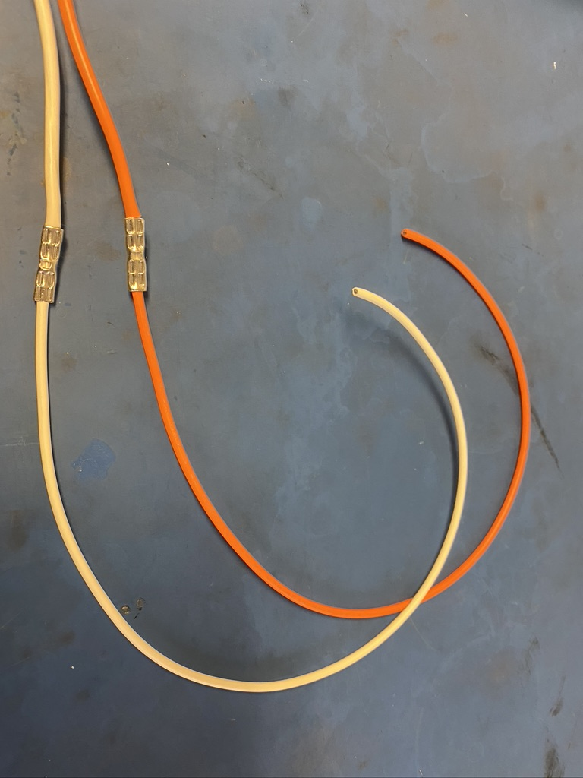
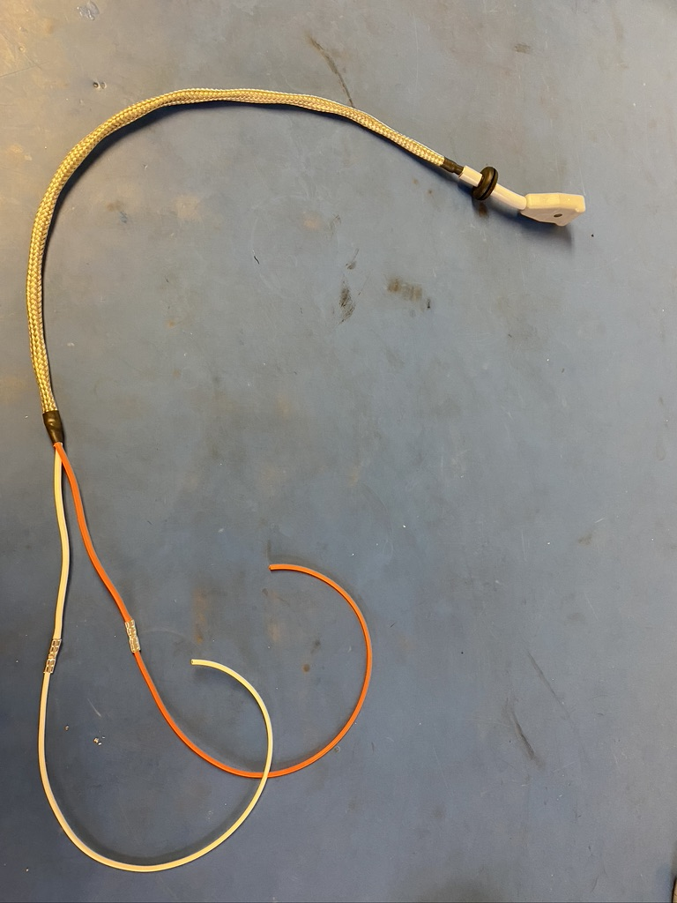
Crimp the terminals twice again so they appear as show on the left. So far, the wire harness should appear as shown on the right.

Slide 22
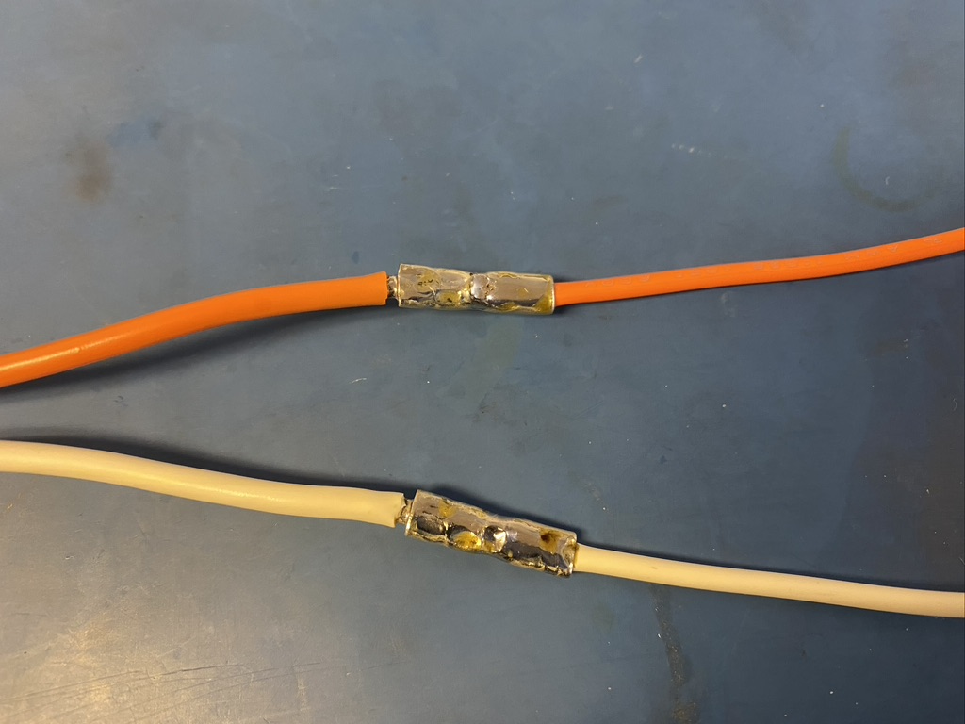
Solder the terminals. Try to put solder into the hole in the middle of the terminals so that solder can flow inside.

Slide 23
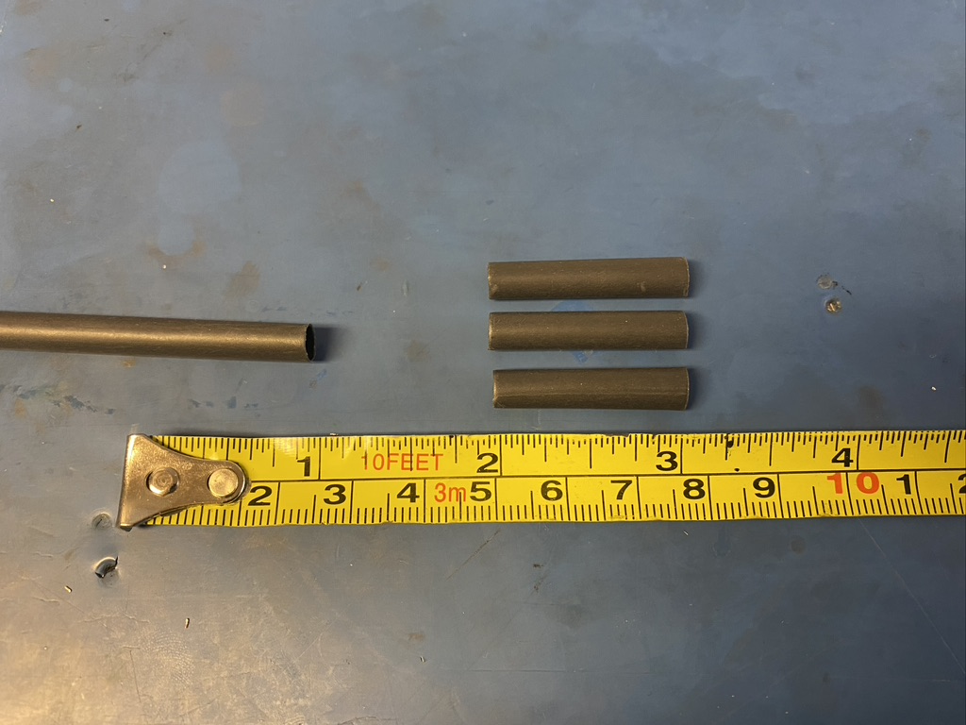
Measure out and cut three lengths of 4.8mm adhesive shrink tube each 1in long.

Slide 24
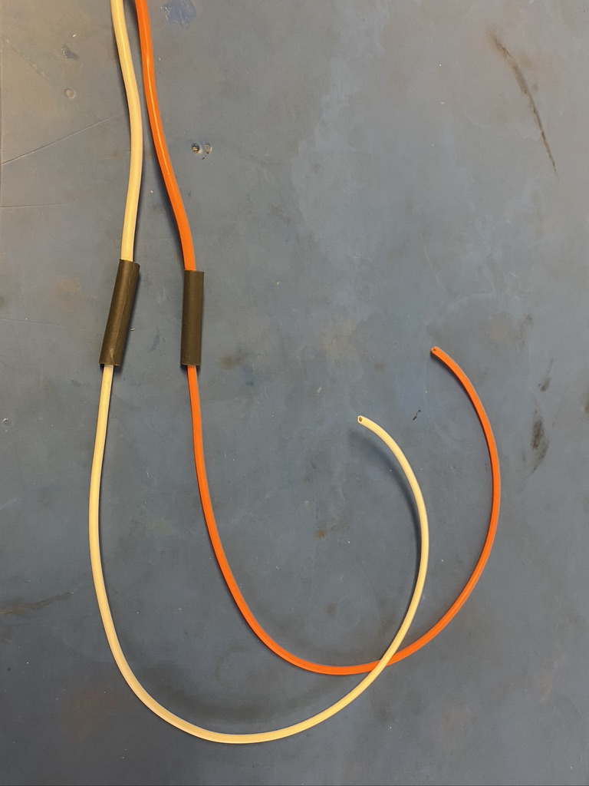
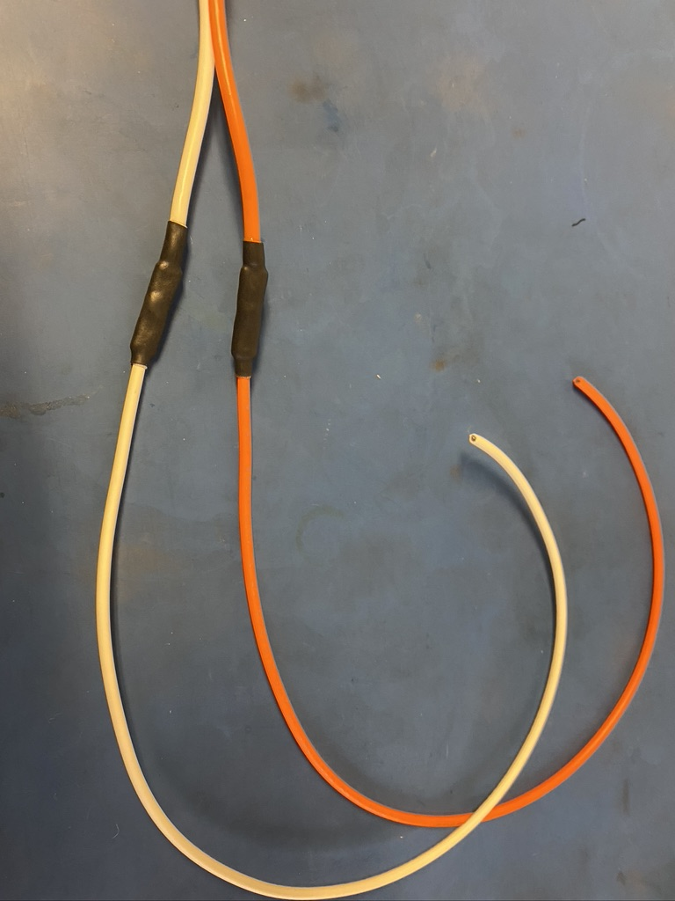
Place one length of the 4.8mm shrink tube on each wire to cover the terminals. Apply the heat gun.

Slide 25
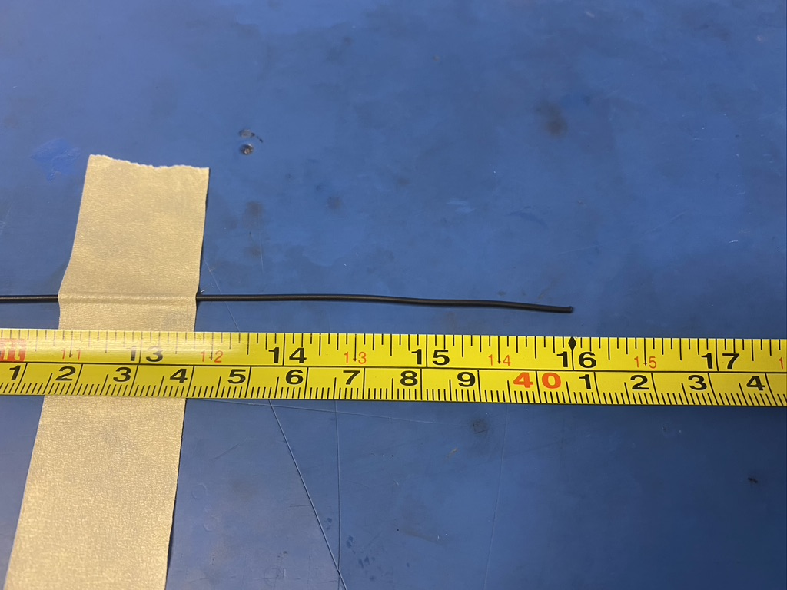
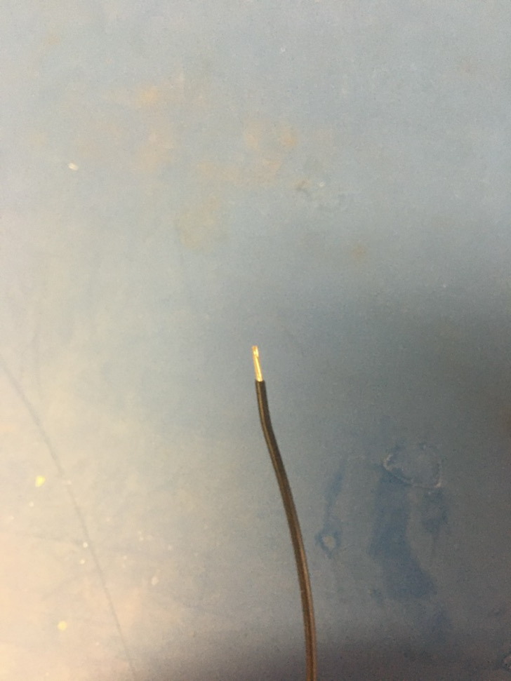
Measure out and cut 16 inches of black 24 awg wire. Strip 3-4mm off one end.

Slide 26
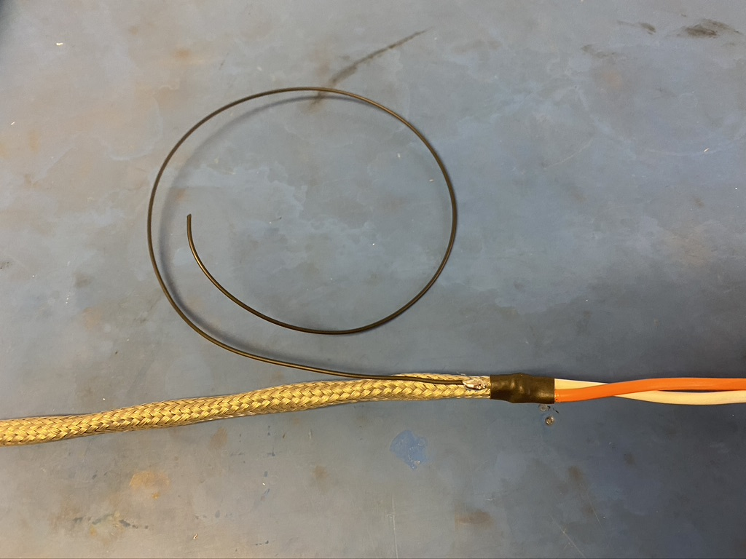
Solder the stripped end of the black wire onto the metal braid near the metal braid shrink tube joint furthest from the plug. The black wire should be soldered so the that its length runs with that of the metal braid.

Slide 27
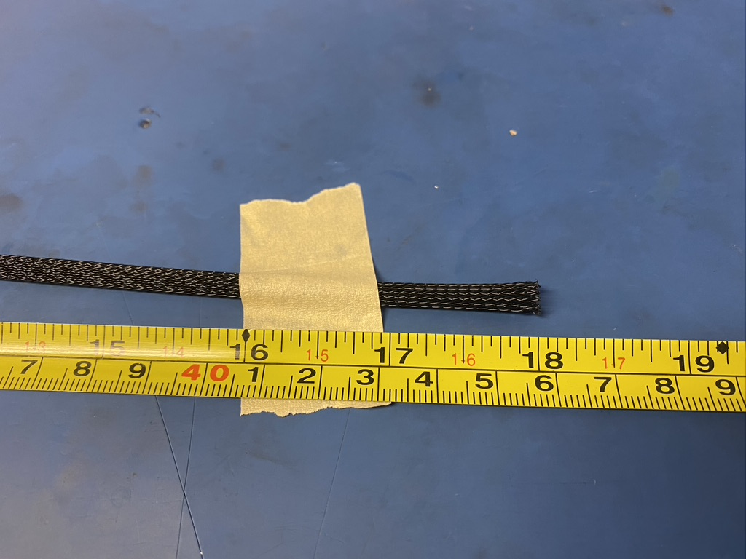
Measure out and cut 18 inches of 1/4th plastic braid.

Slide 28
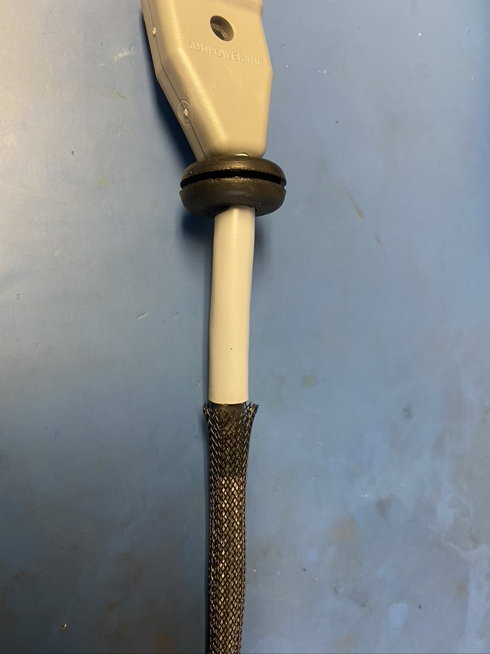
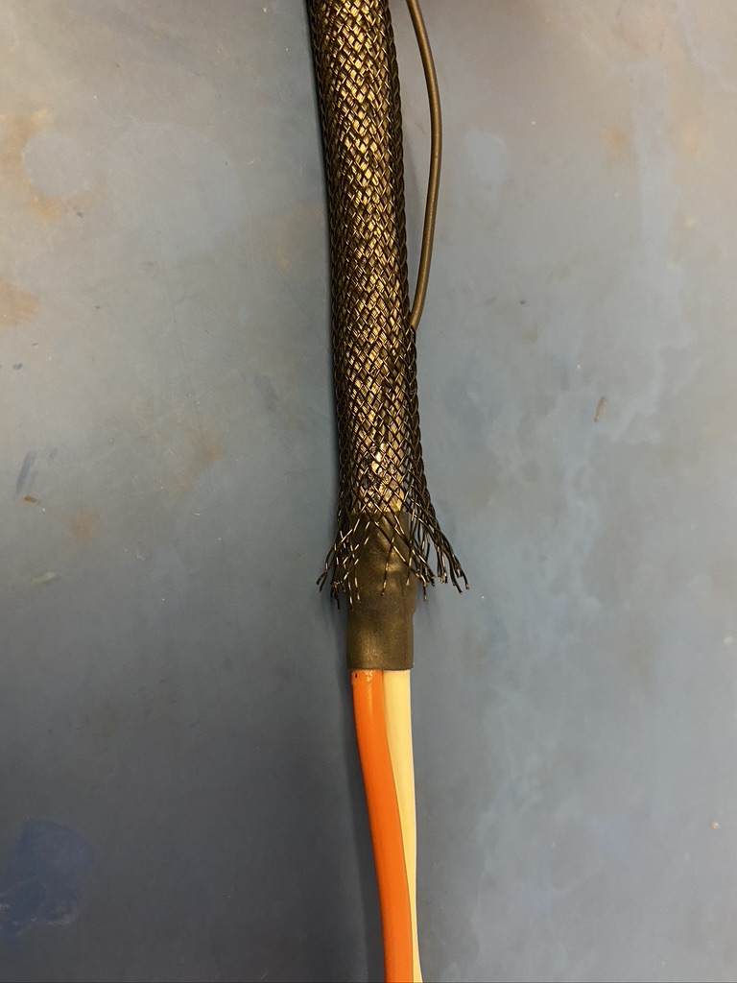
Put the plastic braid onto the wire harness. The end next to the plug should be just touching the end of grey isolation as shown on the left. On the other end, thread the ground wire through the plastic braid. The braid should end midway through the piece of shrink tube beneath it.

Slide 29
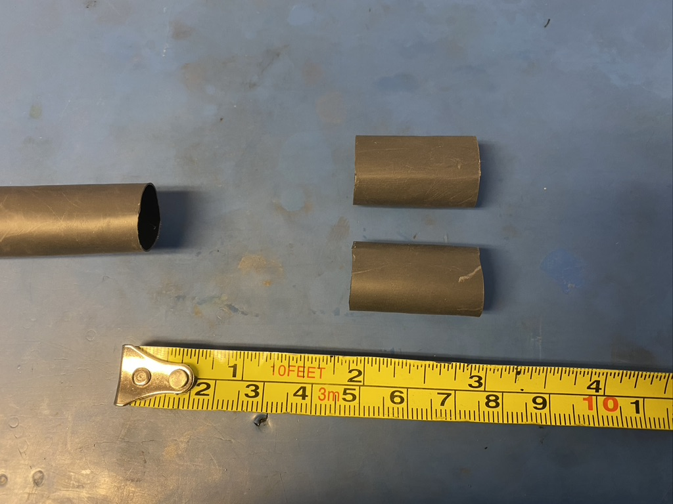
Measure out and cut two lengths of 12.7mm adhesive shrink tube each 1in long.

Slide 30
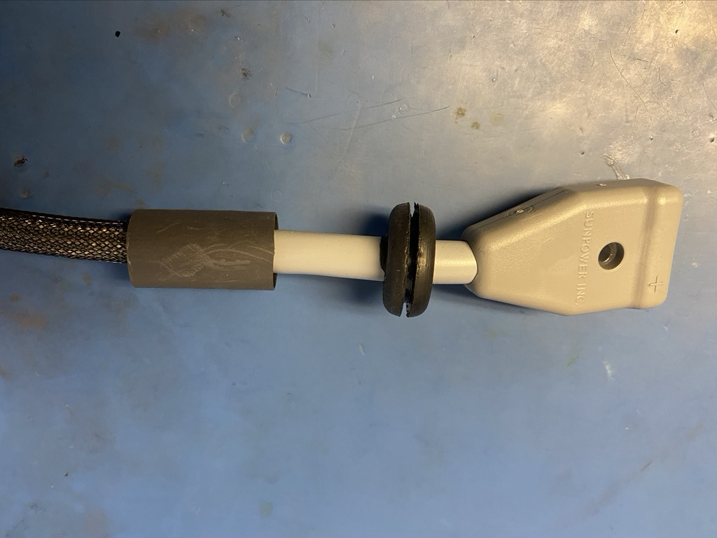
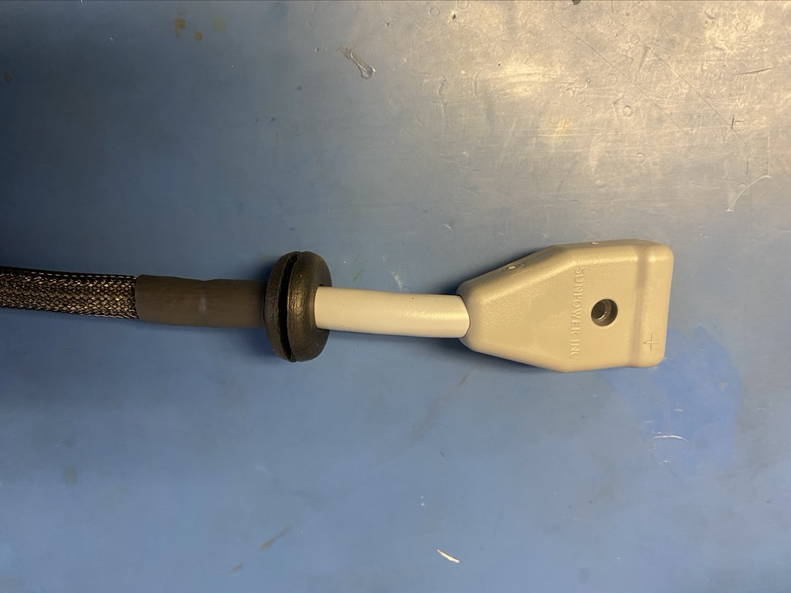
Take one piece of the shrink tube and put it on the plug and plastic braid joint. The end of the plastic braid and beginning of the plug should be in the middle of the length of shrink tube. Apply the heat gun.

Slide 31
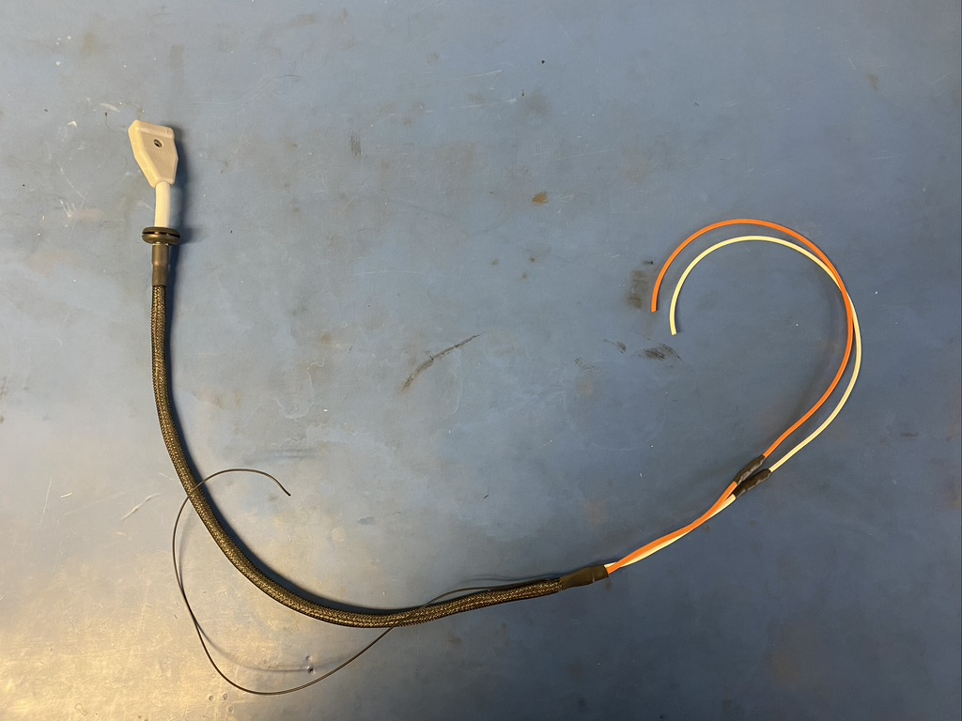
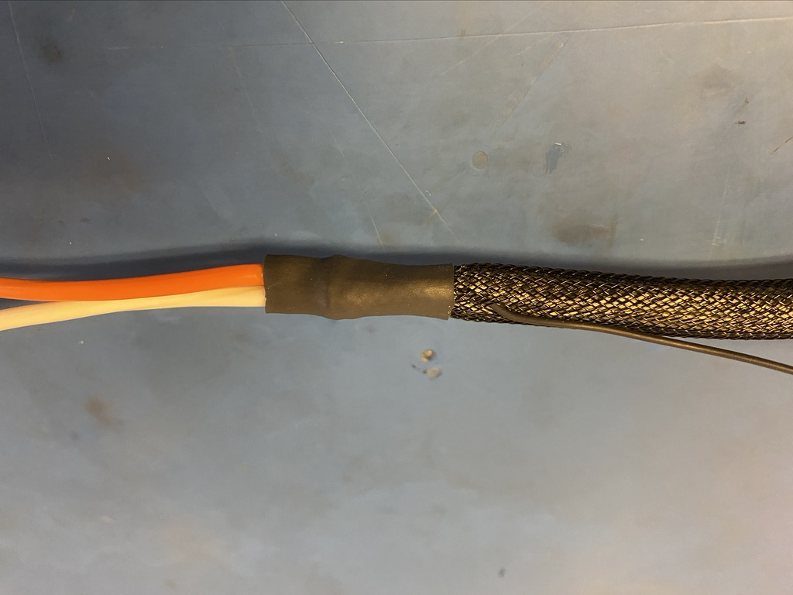
Take the second piece of shrink tube and put it on the remaining exposed end of the plastic braid. The shrink tube should be placed such that it covers the solder joint and the length of shrink tube beneath. Apply the heat gun. Thus far, the harness should appear as shown on the right.

Slide 32
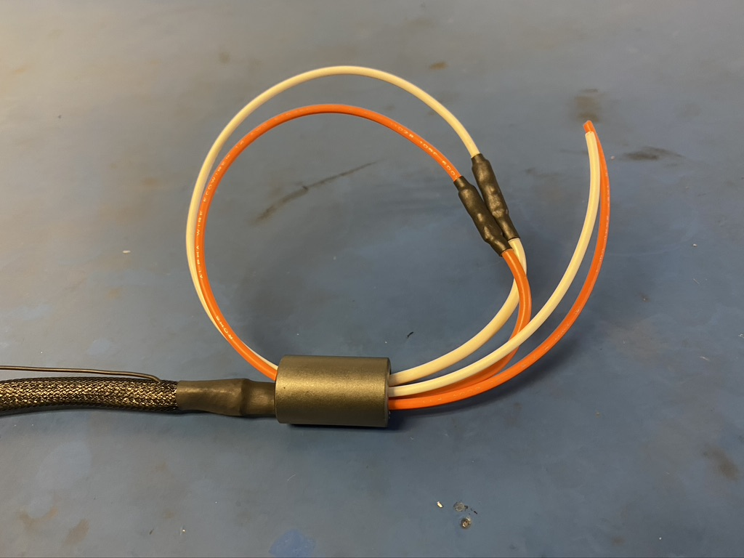
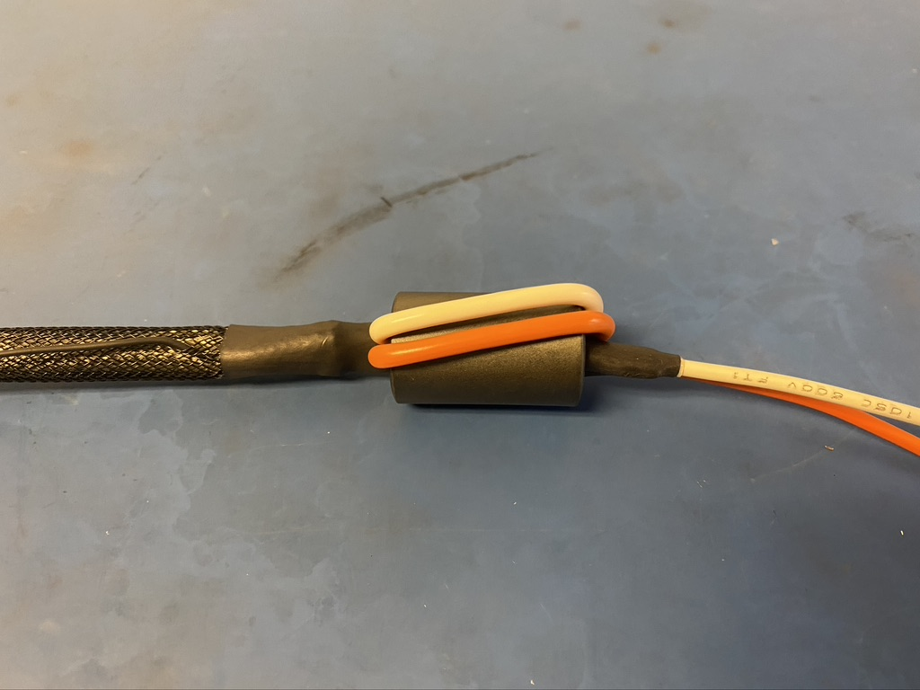
Thread the 75 magnet onto the end the wires and then back through the bottom of the magnet as shown on the left. Pull the loop of wire taught so they appear as shown on the right. When pulling the loop of wire through, try to keep the wires parallel.

Slide 33
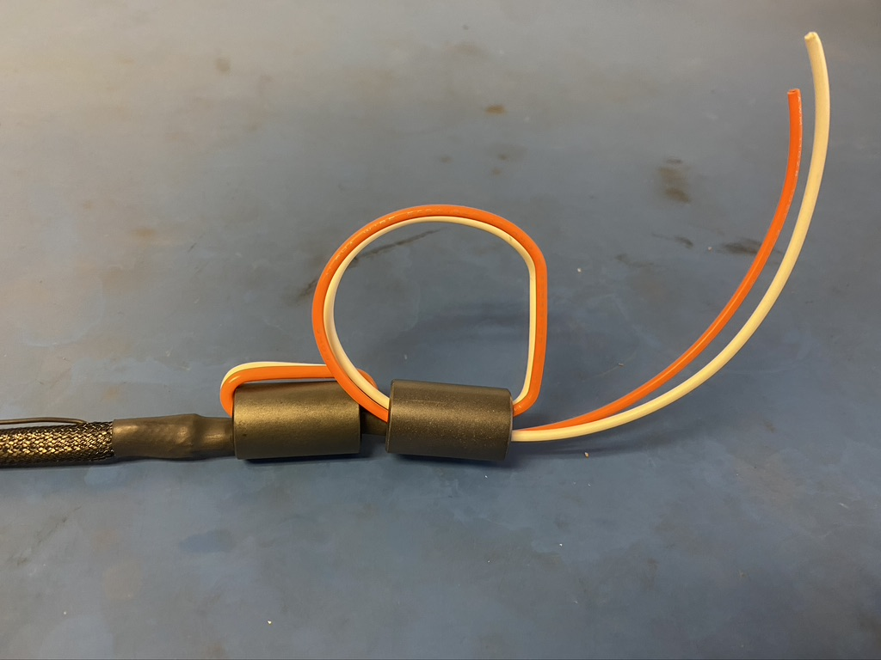
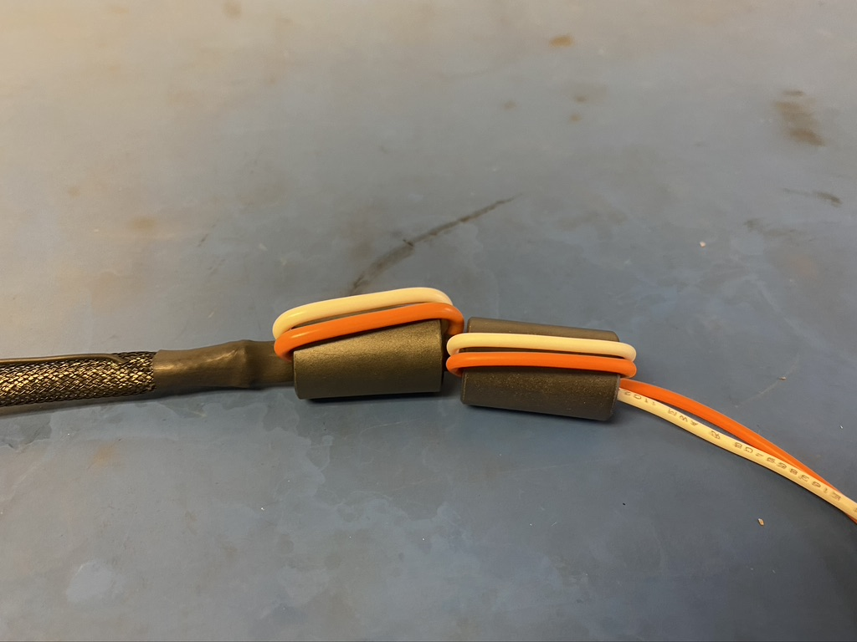
Repeat the process shown on the previous slide with the second 43 magnet.

Slide 34
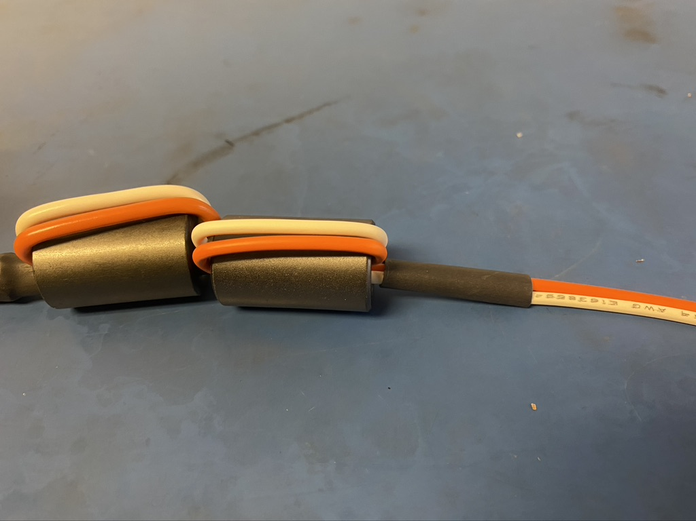
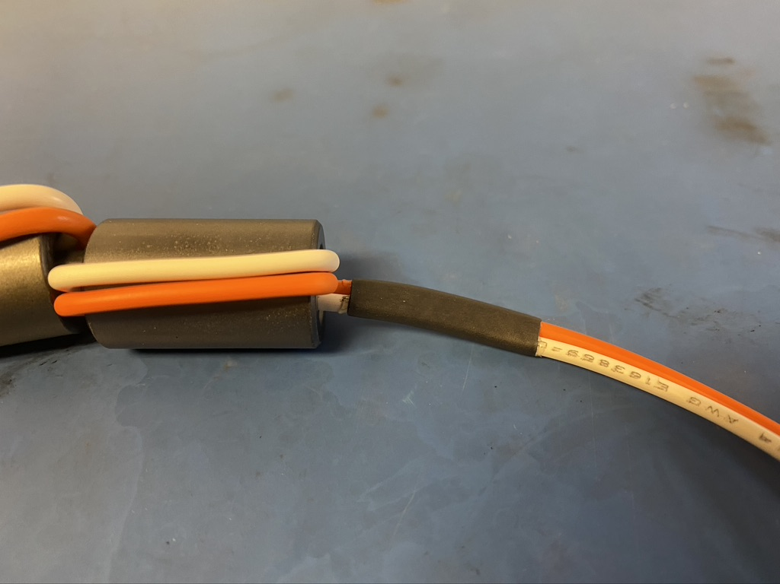
Place the last piece 1in long 4.8mm adhesive shrink tube such that it abuts the magnets. Apply the heat gun.

Slide 35

Measure out and cut one length of 19mm adhesive shrink tube that is 4in long.

Slide 36


Place the piece of 19mm shrink tube over the magnets so that roughly the same amount of shrink tube is visible coming out either end. Apply the heat gun.

Slide 37

Wire harness complete! The orange, white, and ground wire will be given tips later.

